Slide 1

Total Quality Management in Software Engineering: A Case Study of CrowdStrike
This presentation will explore how Total Quality Management (TQM) principles can be applied to software quality assurance, using the CrowdStrike incident as a case study.

Slide 2
CrowdStrike: Impact and Context
Critical Infrastructure Impact
Software Outage
Airlines
A widespread software outage impacted critical systems, highlighting the urgent need for robust quality management in software development.
Healthcare
Finance
Emergency Services

Slide 3

TQM Principle 1: Continuous Improvement
1
Pre-Incident Gap
2
TQM Solution
3
CrowdStrike Example
Lack of proactive monitoring and real-time feedback mechanisms.
Implementing continuous integration and continuous delivery (CI/CD) pipelines with automated testing.
Introducing automated code analysis and defect tracking tools to identify and resolve issues early.

Slide 4

TQM Principle 2: Employee Involvement
Pre-Incident Gap
TQM Solution
Limited communication and collaboration between development teams and quality assurance specialists.
Promoting cross-functional teams and encouraging shared ownership of quality.
CrowdStrike Example
Establishing dedicated quality assurance teams with responsibilities that span the entire software development lifecycle.

Slide 5




TQM Principle 3: Process Approach
Pre-Incident Gap
TQM Solution
CrowdStrike Example
Absence of a well-defined and documented software development process.
Implementing standardized software development methodologies, such as Agile or Waterfall.
Adopting a phased deployment strategy to reduce the impact of potential bugs in the early stages of a release.

Slide 6





TQM Principle 4: Systematic Approach
Implementation
Design
Write code that adheres to coding standards and best practices.
Testing
Develop a robust and scalable software architecture.
Conduct rigorous testing to identify and address defects.
Requirement Gathering
Deployment
Ensure clear and comprehensive user requirements.
Deploy the software in a controlled and monitored environment.
3
2
4
1
5

Slide 7

TQM Principle 5: Integrated System
Requirement Analysis
Testing and Validation
Quality considerations are integrated from the outset.
Multiple levels of testing, including unit, integration, and system testing.
1
2
3
4
Design Review
Deployment and Monitoring
Code reviews and design audits are conducted.
Continuous monitoring and feedback loops to identify and resolve issues in production.

Slide 8
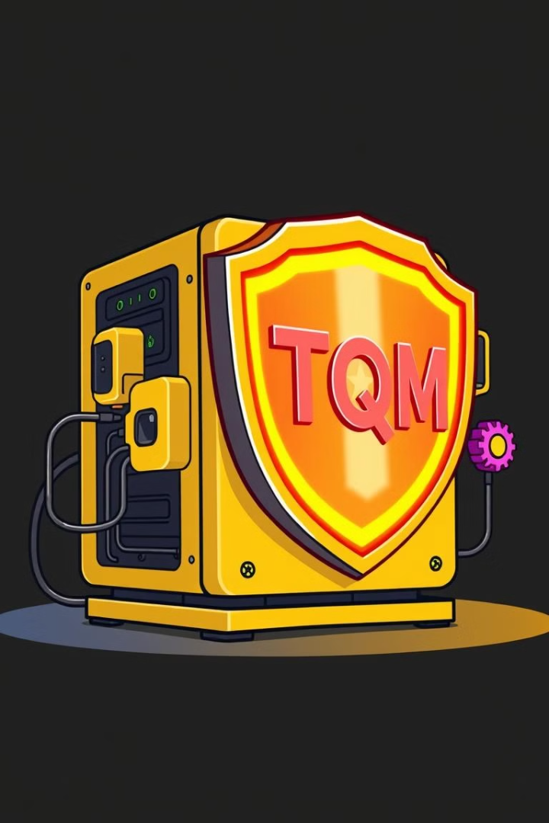



Lessons Learned: TQM for Software Resilience
Proactive Approach
TQM encourages a proactive approach to software quality, rather than reactive measures.
Early Detection
By incorporating quality checks throughout the development lifecycle, potential issues are identified and addressed early.
Continuous Improvement
TQM fosters a culture of continuous improvement, ensuring that software systems evolve and adapt to meet changing needs.

Slide 9
Lessons Learned: TQM for Software Resilience
Continuous Improvement is key: Feedback loops, root cause analysis, and adaptive approaches are vital for ongoing optimization.
Collaboration is crucial: Cross-functional teams ensure comprehensive quality assurance, bridging the gap between development and security.
A systematic approach: By implementing standardized methodologies and integrating quality into every stage, you can build a robust and resilient software foundation.

Slide 10
Test Plan for Software Quality
1
Objectives
2
Metrics
3
Methodologies
Identify defects, ensure reliability, validate functionality, and improve user experience.
Defect density, test coverage, test execution rate, defect resolution time, and customer satisfaction.
Unit testing, integration testing, system testing, regression testing, and user acceptance testing.

Slide 11



Continuous Improvement Strategies
Feedback Loops
Root Cause Analysis
Agile/DevOps
Gathering and acting on user and system feedback to iteratively improve software quality and resilience.
Identifying and addressing the underlying causes of defects and vulnerabilities to prevent recurrence.
Adopting Agile and DevOps methodologies to promote continuous integration, delivery, and feedback.
By implementing these continuous improvement strategies, CrowdStrike can proactively address issues, enhance software resilience, and maintain a high level of quality.

Slide 12
References
Centers for Disease Control and Prevention. (2023, March 16). Antibiotic Resistance Threats in the United States 2019. CDC. https://www.cdc.gov/drugresistance/pdf/threats-report/2019-ar-threats-report-508.pdf
The World Bank. (2018, March 6). Drug-Resistant Infections: A Threat to Our Economic Future. World Bank. https://www.worldbank.org/en/news/feature/2017/03/06/drug-resistant-infections-a-threat-to-our-economic-future
Manyika, J., Chui, M., Miremadi, M., Bughin, J., Allas, T., Dahlström, P., ... & Ramaswamy, S. (2017). A new report from McKinsey Global Institute— Tackling the world’s greatest challenges: Our response to antimicrobial resistance. McKinsey. https://www.mckinsey.com/~/media/mckinsey/business%20functions/strategy%20and%20corporate%20finance/our%20insights/tackling%20the%20worlds%20greatest%20challenges/tackling-the-worlds-greatest-challenges-full-report.ashx
O’Neill, J. (2016). Tackling drug-resistant infections globally: final report and recommendations. Welcome Trust and HM Government.

